Slide 1
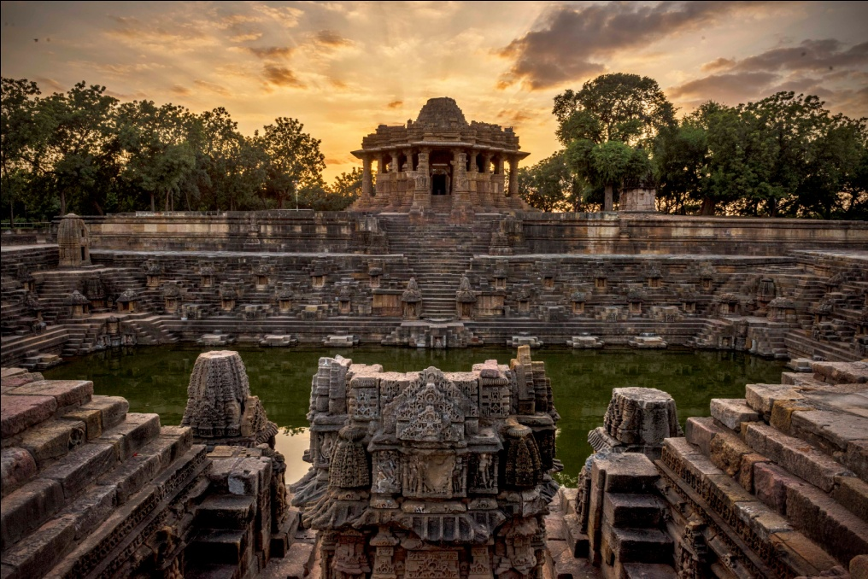
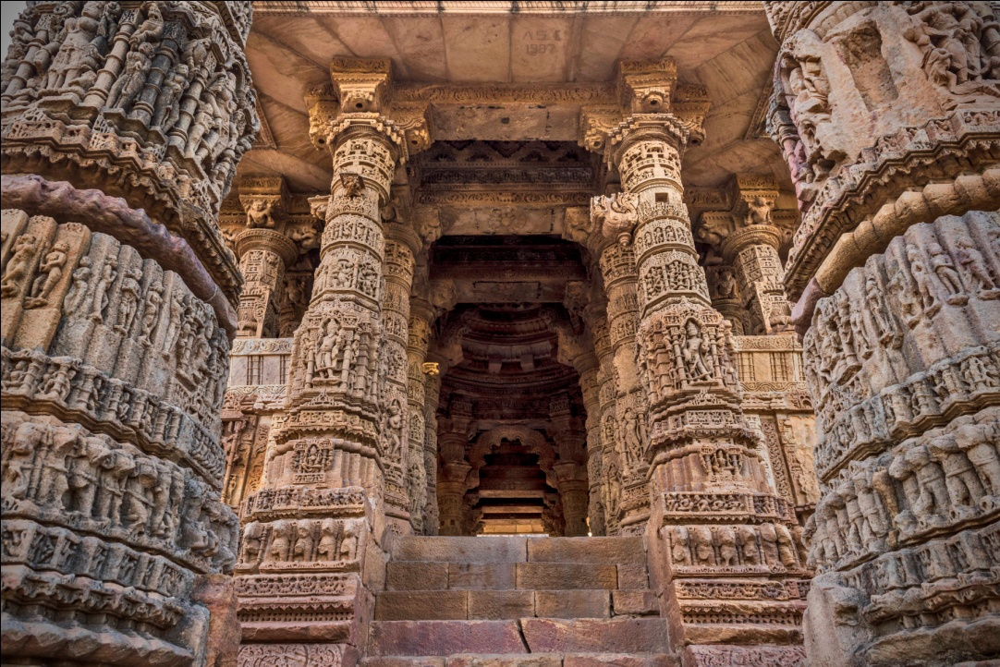
Sun Temple Modhera
Sun Temple is dedicated to the solar deity Surya located at Modhera village of Mehsana district, Gujarat, India
It was built in 1026-27 AD during the reign of Bhima I of the Chaulukya dynasty.

Slide 2
The temple is a classic example of the material aspect of Solanki architecture, namely a mastery over the elegantly intricate carving of stone and the judicious use of lime mortar.
The kund and the entrance passageway face east in an aura of welcome to the tantalizing rays of the sun, and the entire structure floats on a plinth resembling a flowering lotus as an ablution to the sun god.
The main complex is divided into three parts, the entrance which is the ‘Sabha Mandap’, ‘Antaral’ the connecting passage and the ‘Garbagruha’, the sanctum sanctorum.

Slide 3
